Slide 1
9.1: Conics
MATH 1550 - Precalculus

Slide 2
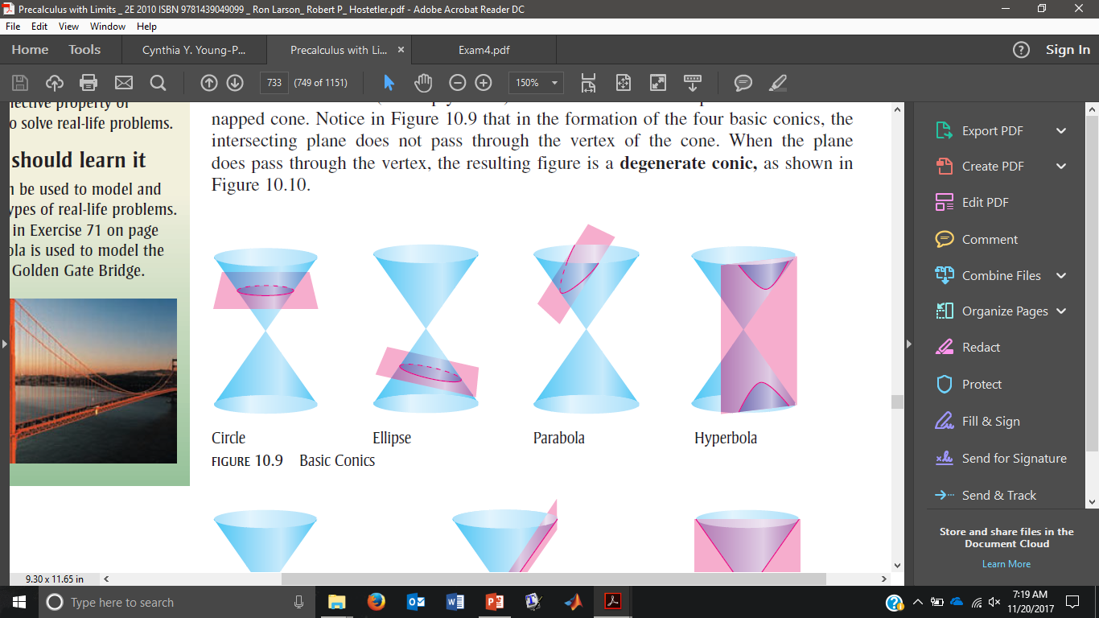
Circle

Slide 3
Ellipse

Slide 4
Parabola

Slide 5
Hyperbola

Slide 6
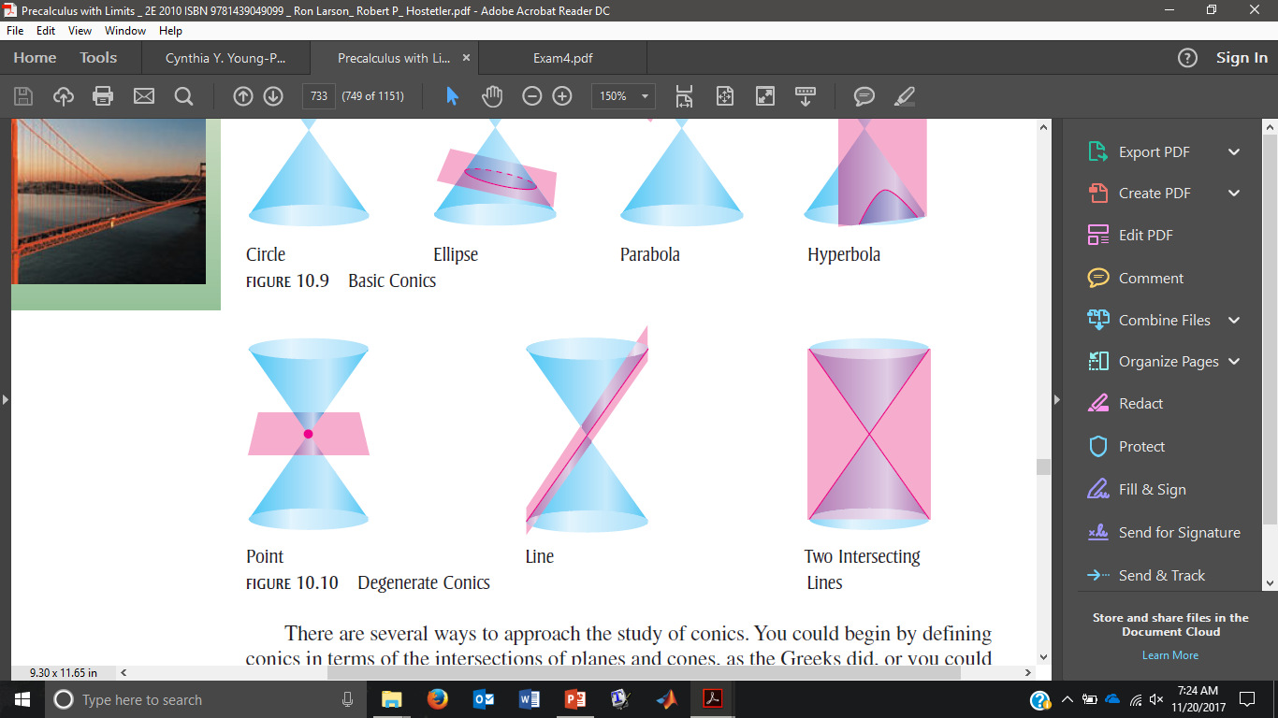
Point

Slide 7
Line

Slide 8
Intersecting Lines

Slide 9

General Form of a 2nd-Degree Equation in 2 Variables
Conic | Discriminant
Ellipse (and circles) | Negative
Parabola | Zero
Hyperbola | Positive
$$Ax^{2}+Bxy+Cy^{2}+Dx+Ey+F=0$$
The discriminant $B^{2}−4AC$helps determine what the equation above represents graphically.
WATCH OUT FOR DEGENERATE CONICS!

Slide 10

Ex) Determine what type of conic corresponds to each of the following equations:
$2x^{2}+y^{2}=4$
$2x^{2}=y^{2}+4$
$2y^{2}=x$
Notes:
Ellipse Hyperbola Parabola

Slide 11
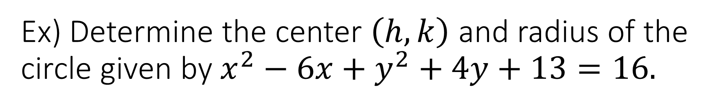
Ex) Determine the center $\left(h,k\right)$ and radius of the circle given by $x^{2}−6x+y^{2}+4y+13=16.$

Slide 12
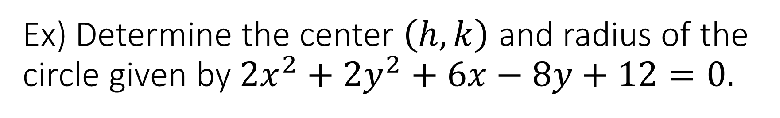
Ex) Determine the center $\left(h,k\right)$ and radius of the circle given by $2x^{2}+2y^{2}+6x−8y+12=0.$

